Slide 1

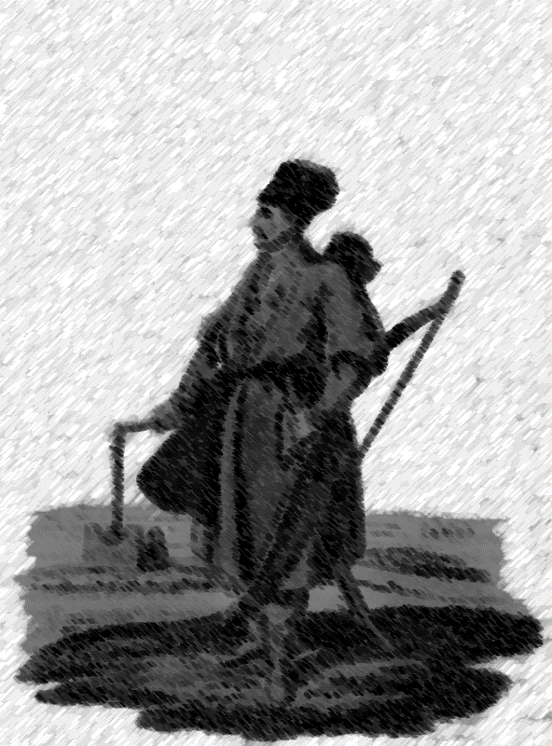
This is a Turcoman. He can be your enemy or your friend. I don’t know.
This text can be your enemy, too. I don’t know.
What the hell do I know.
Damn, but I gotta know something.

Slide 2
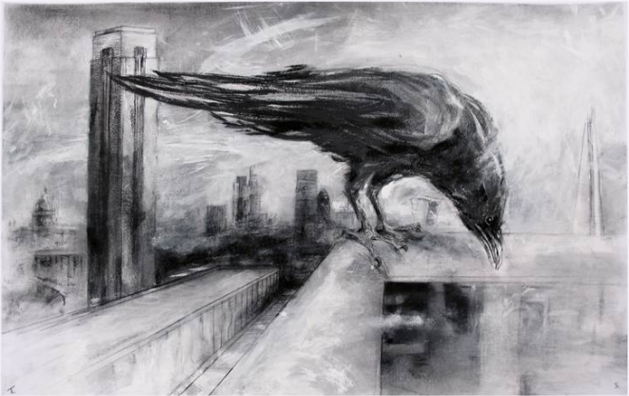

Slide 3
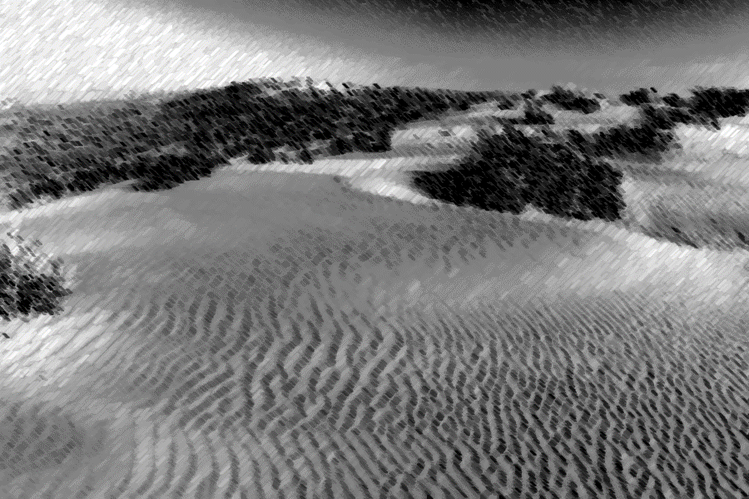

Slide 4


This is a Turcoman. He can be your enemy or your friend. I don’t know.
This text can be your enemy, too. I don’t know.
What the hell do I know.
Damn, but I gotta know something.
Will this be a good UI?
Fk… I don’t know…
Let’s hope it is…
Notes:
When passage is complete, “book flipping” occurs.

Slide 5
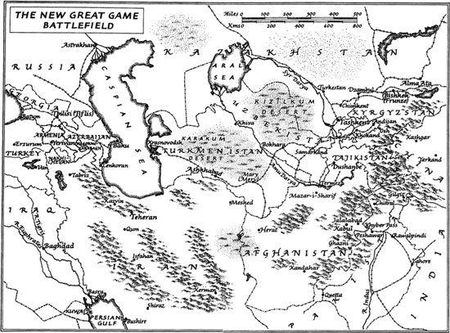

Slide 6

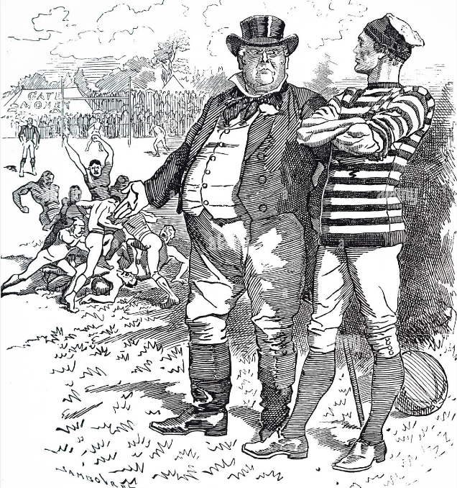


Slide 7

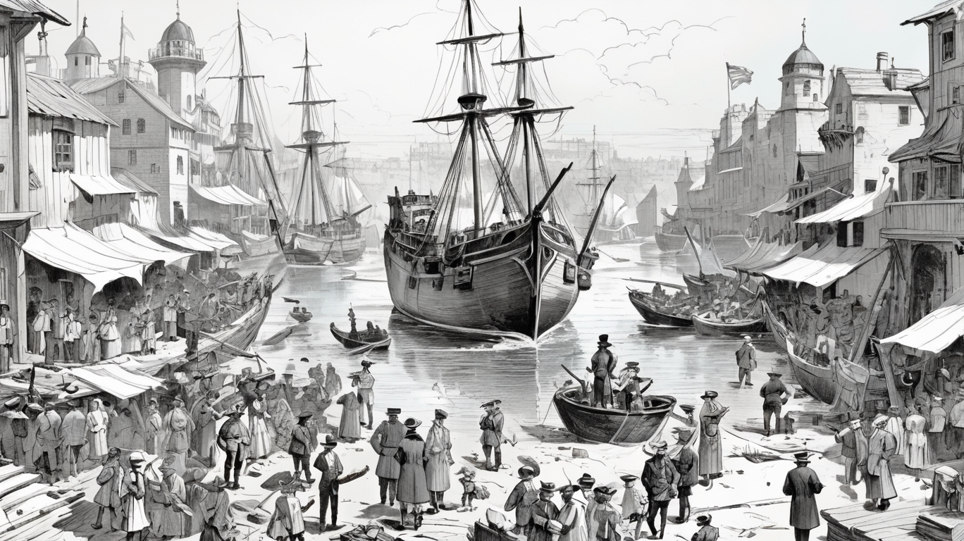
This is a Turcoman. He can be your enemy or your friend. I don’t know.
This text can be your enemy, too. I don’t know.
What the hell do I know.
Damn, but I gotta know something.
Will this be a good UI?
Fk… I don’t know…
Let’s hope it is…

Slide 8

This is a Turcoman. He can be your enemy or your friend. I don’t know.
This text can be your enemy, too. I don’t know.
What the hell do I know.
Damn, but I gotta know something.
Will this be a good UI?
Fk… I don’t know…
Let’s hope it is…

Slide 9

This is a Turcoman. He can be your enemy or your friend. I don’t know.
This text can be your enemy, too.
I don’t know.
What the hell do I know.
Damn, but I gotta know something.
Will this be a good UI?
Fk… I don’t know…
Let’s hope it is…

Slide 10




40
This is a Turcoman. He can be your enemy or your friend. I don’t know.
This text can be your enemy, too.
I don’t know.
What the hell do I know.
Damn, but I gotta know something.
Will this be a good UI?
Fk… I don’t know…
Let’s hope it is…
20
Notes:
이걸로 해보자
하… 그런데 어케 구현하냐… 머리 아프누…

Slide 11
This is a Turcoman. He can be your enemy or your friend. I don’t know.
This text can be your enemy, too.
I don’t know.
What the hell do I know.
Damn, but I gotta know something.
Will this be a good UI?
Fk… I don’t know…
Let’s hope it is…
Notes:
이걸로 해보자
하… 그런데 어케 구현하냐… 머리 아프누…

Slide 12
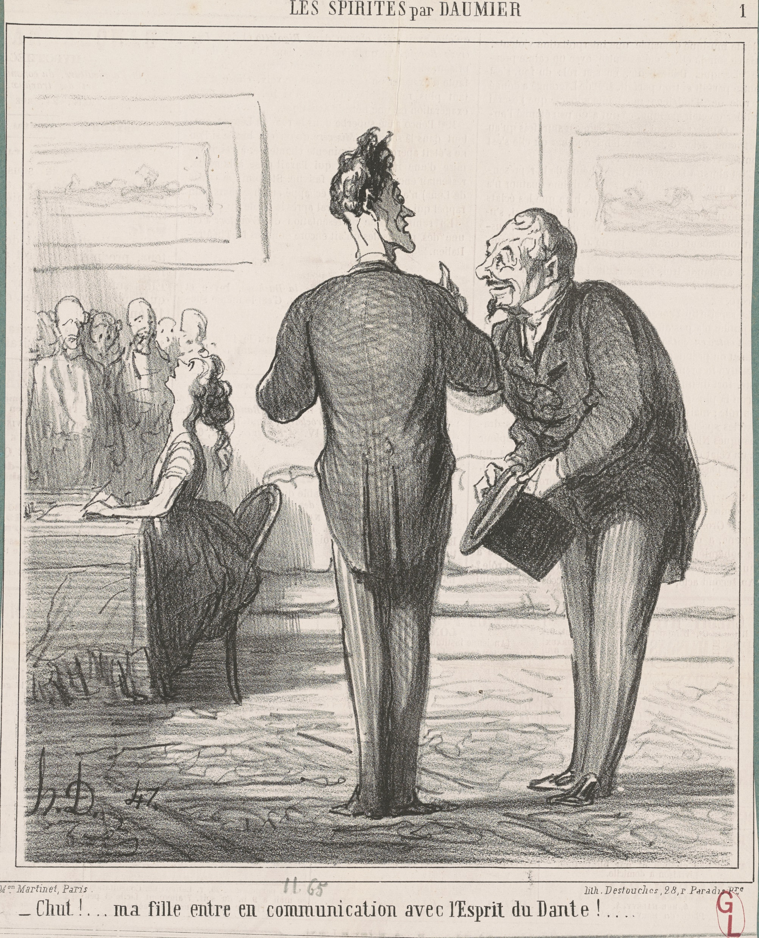

Slide 13
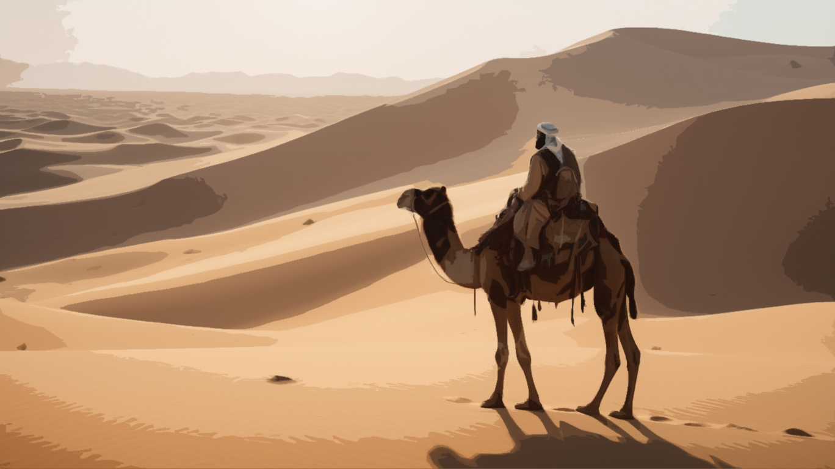

Slide 14
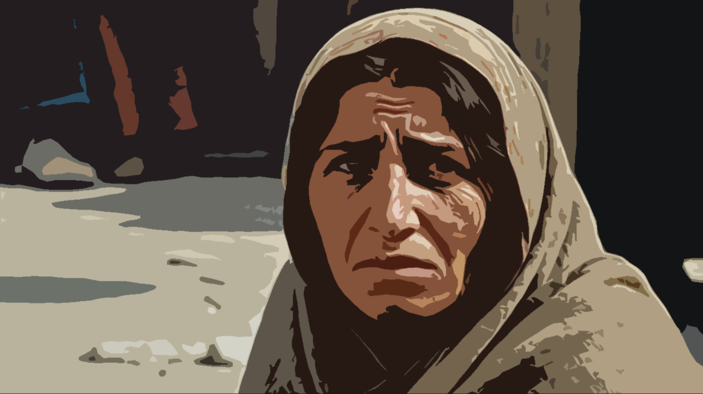

Slide 15
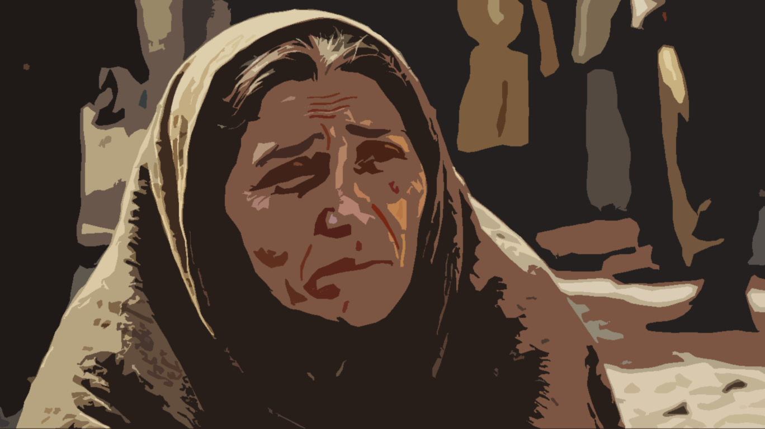

Slide 16
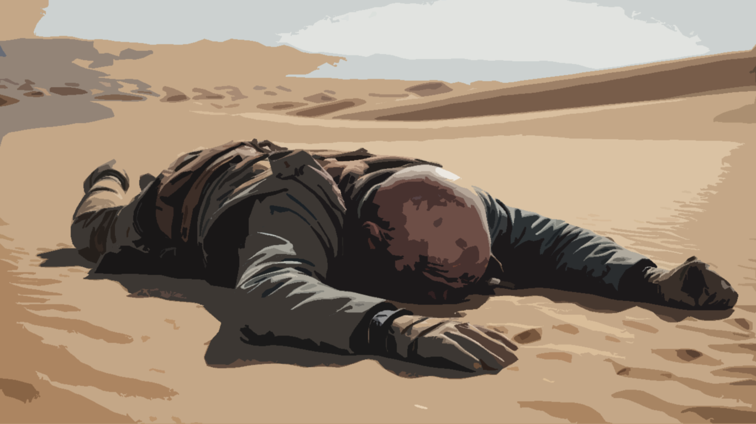

Slide 17


Slide 18
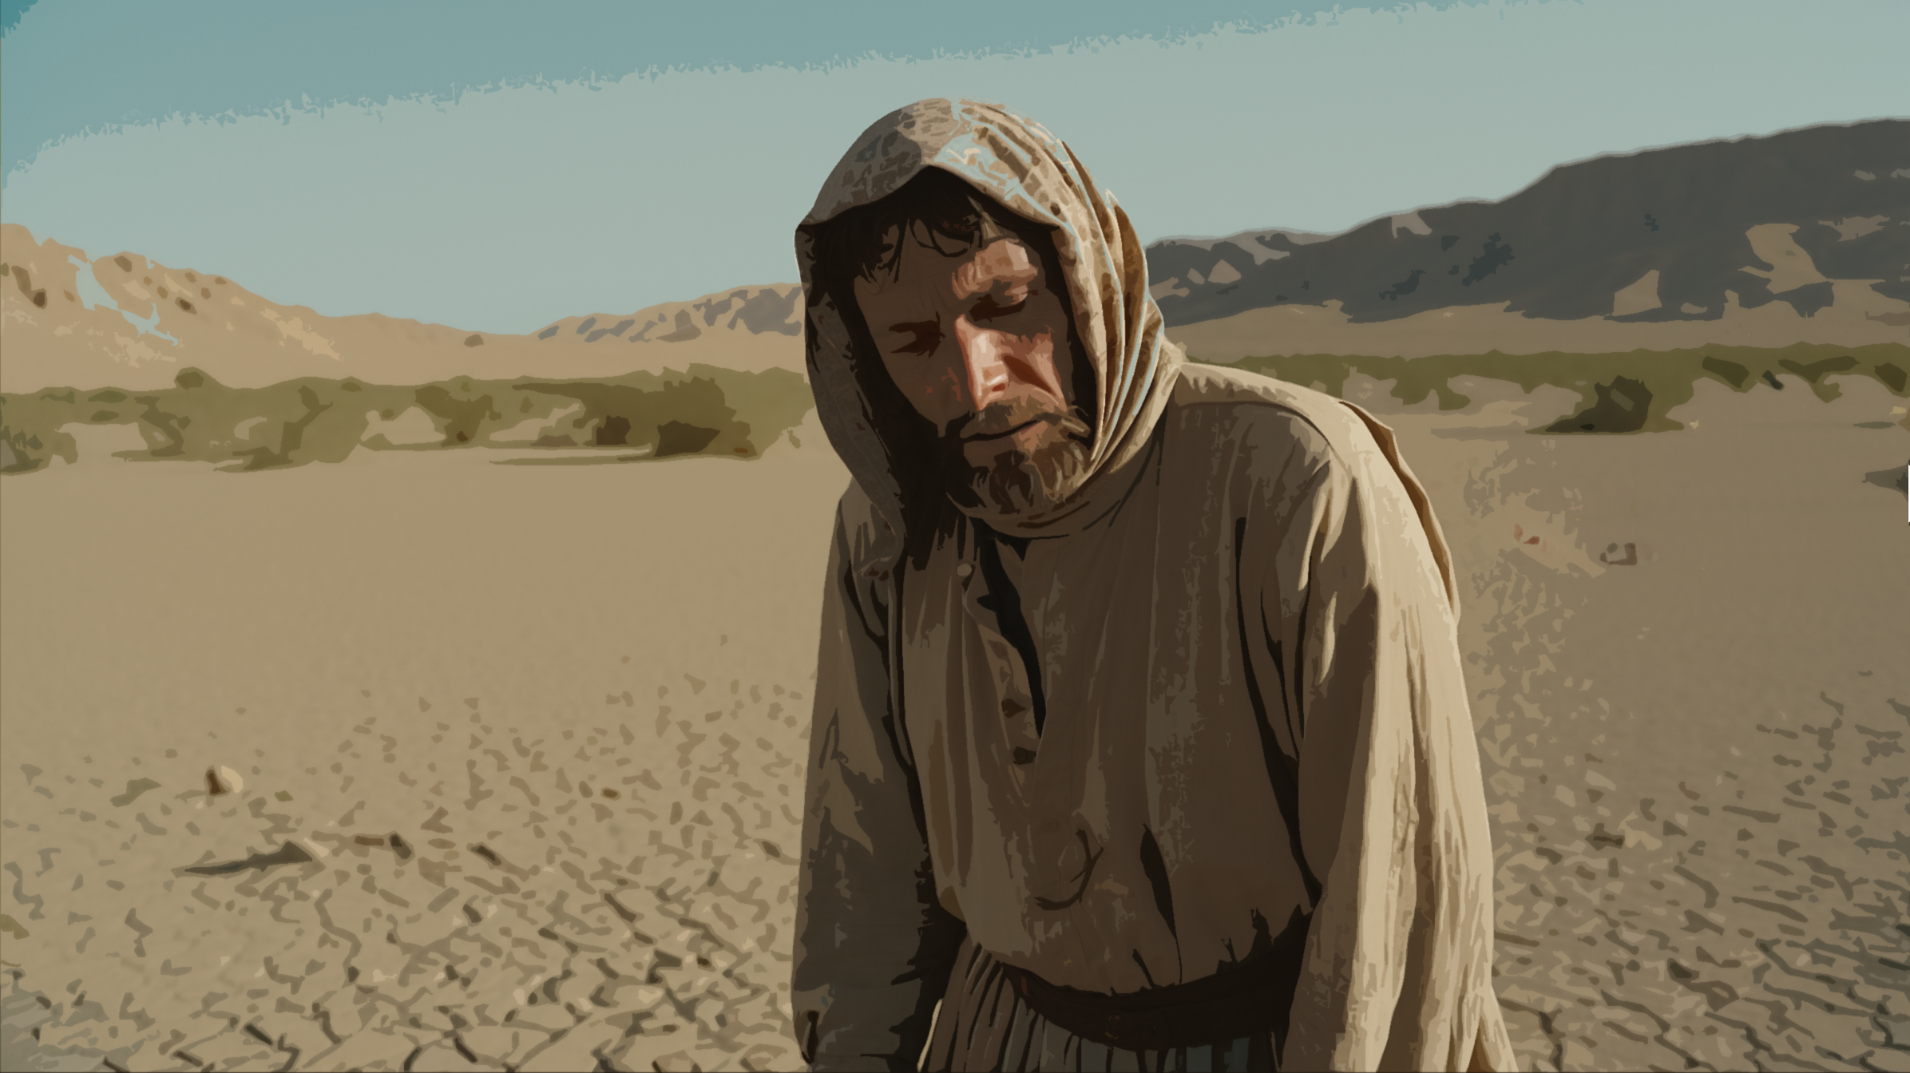

Slide 19


Slide 20
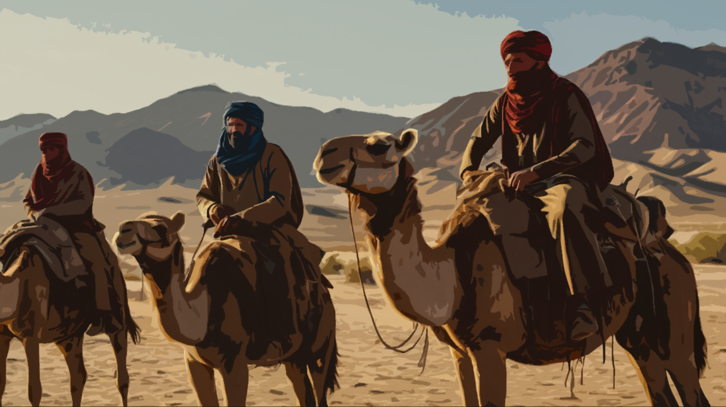

Slide 21
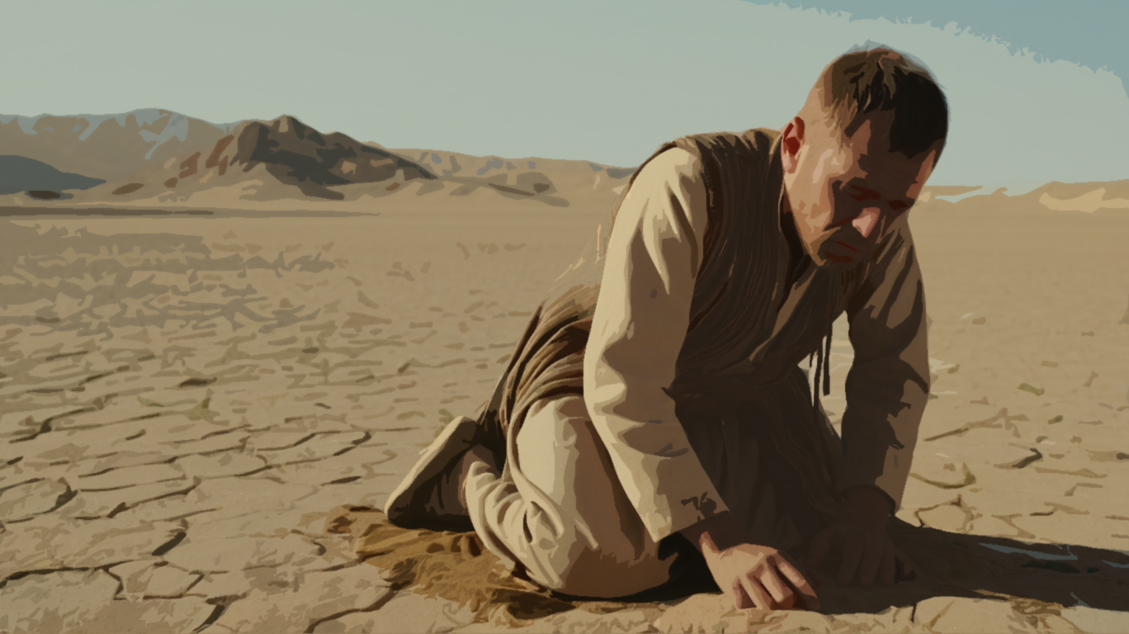

Slide 22


Slide 23


Slide 24
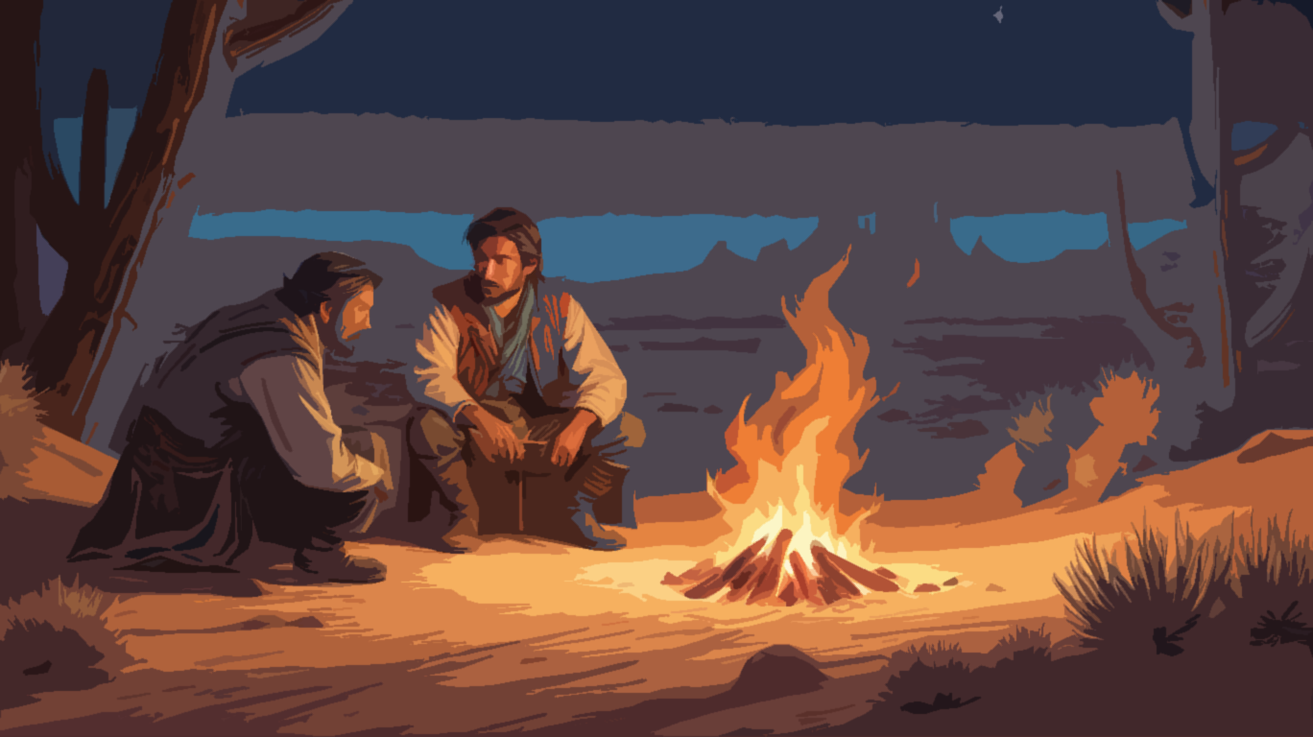

Slide 25
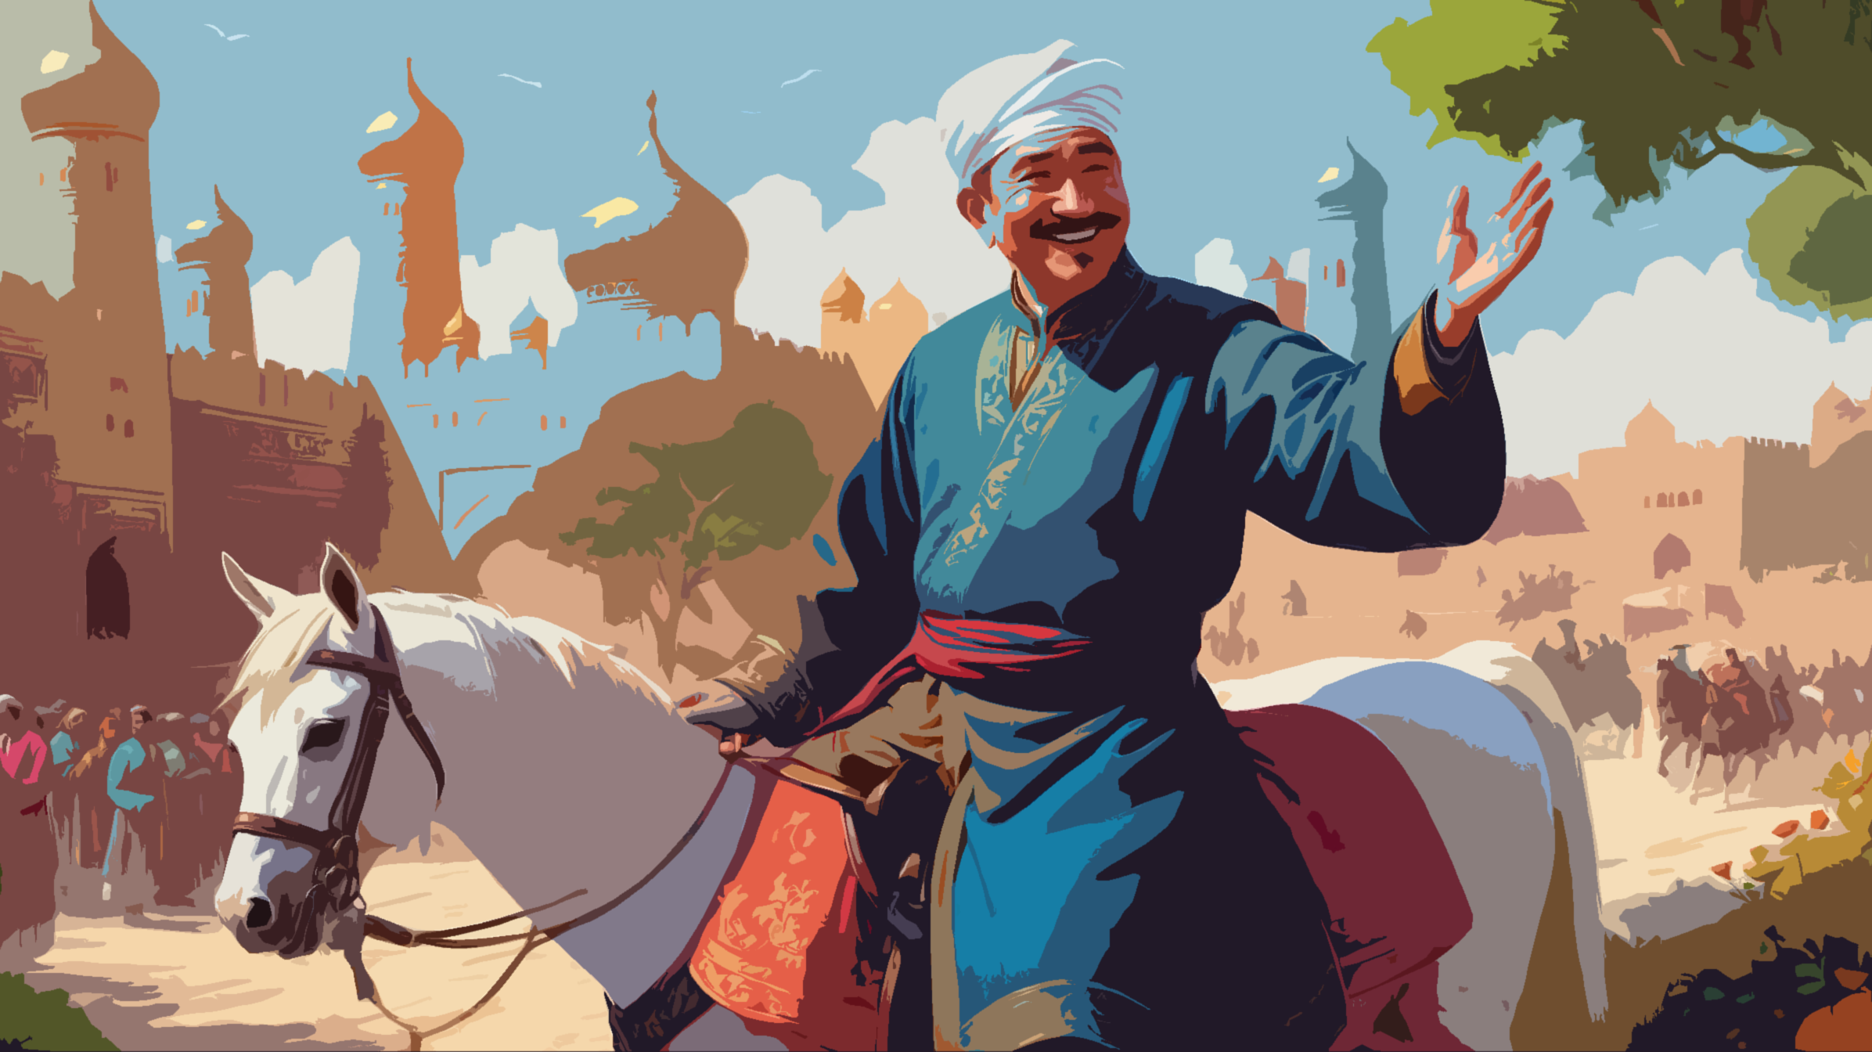

Slide 26
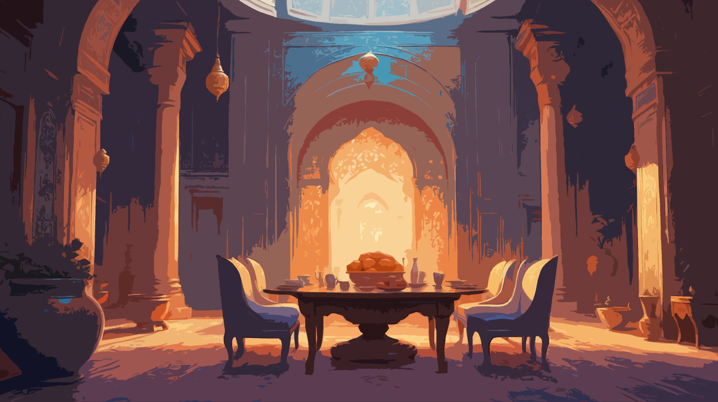

Slide 27
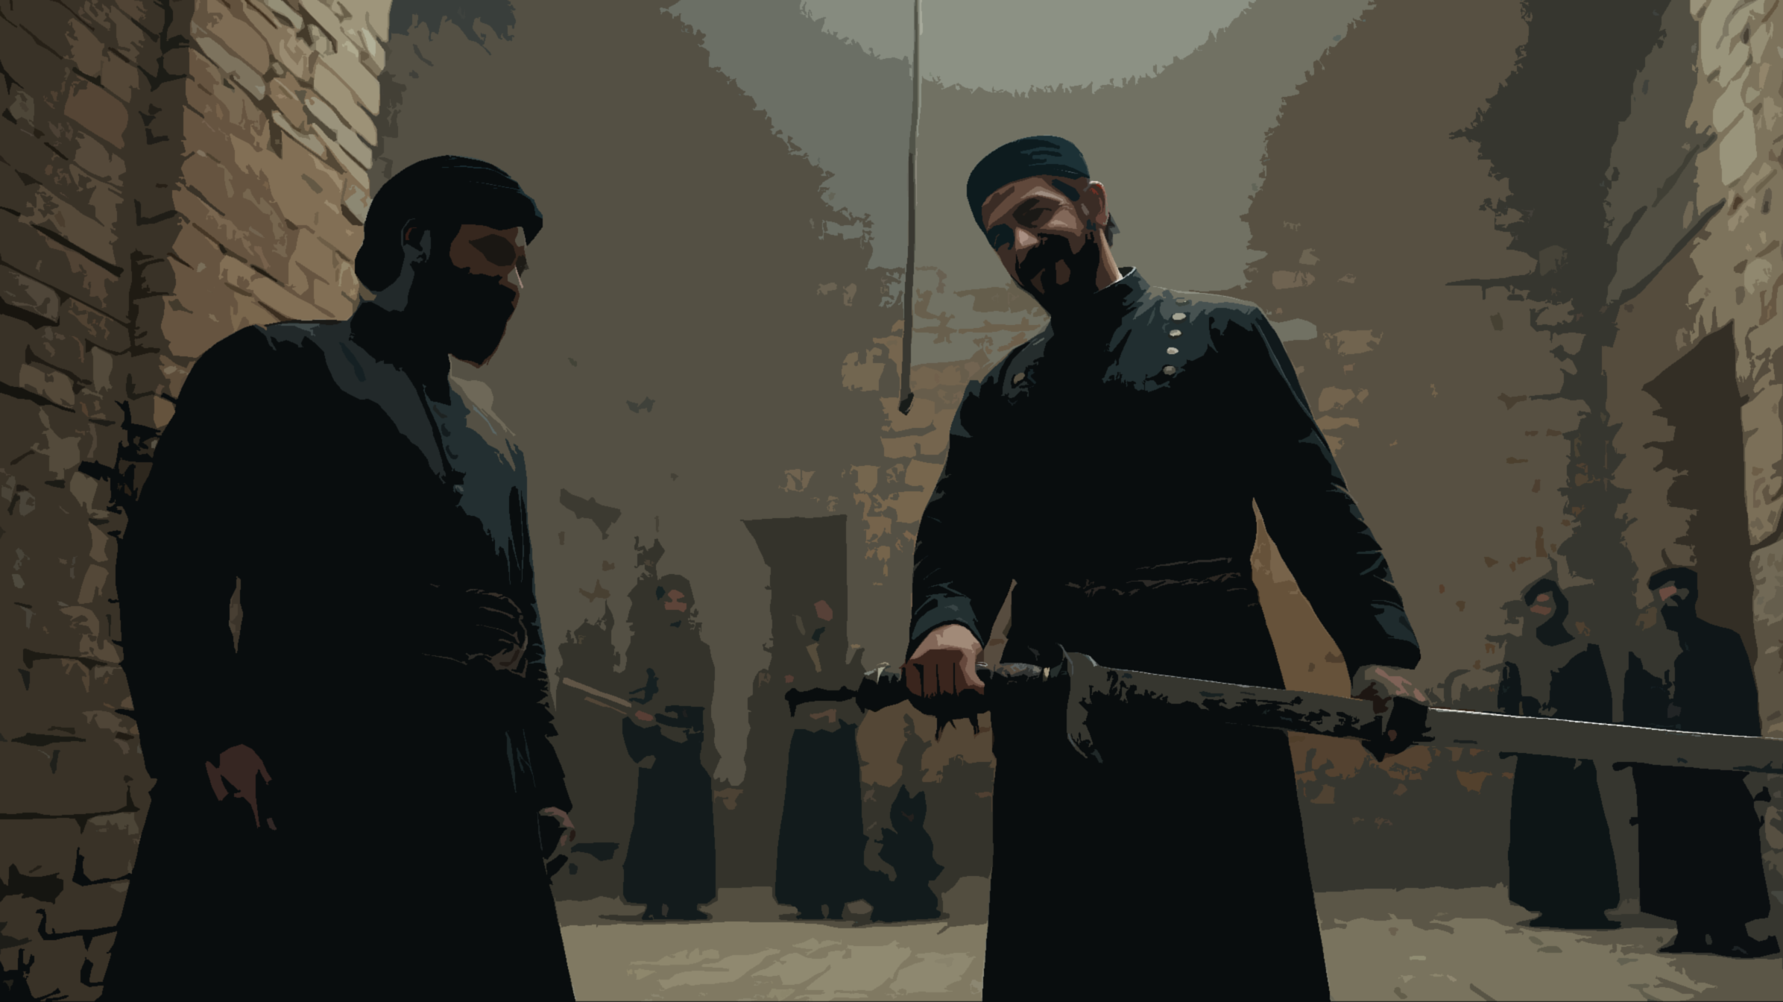

Slide 28


Slide 29


Slide 30

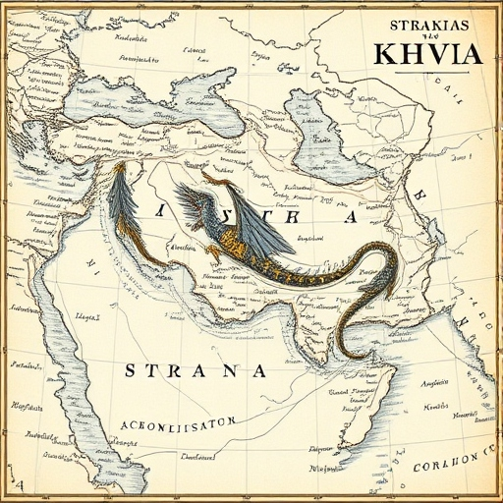

Slide 31
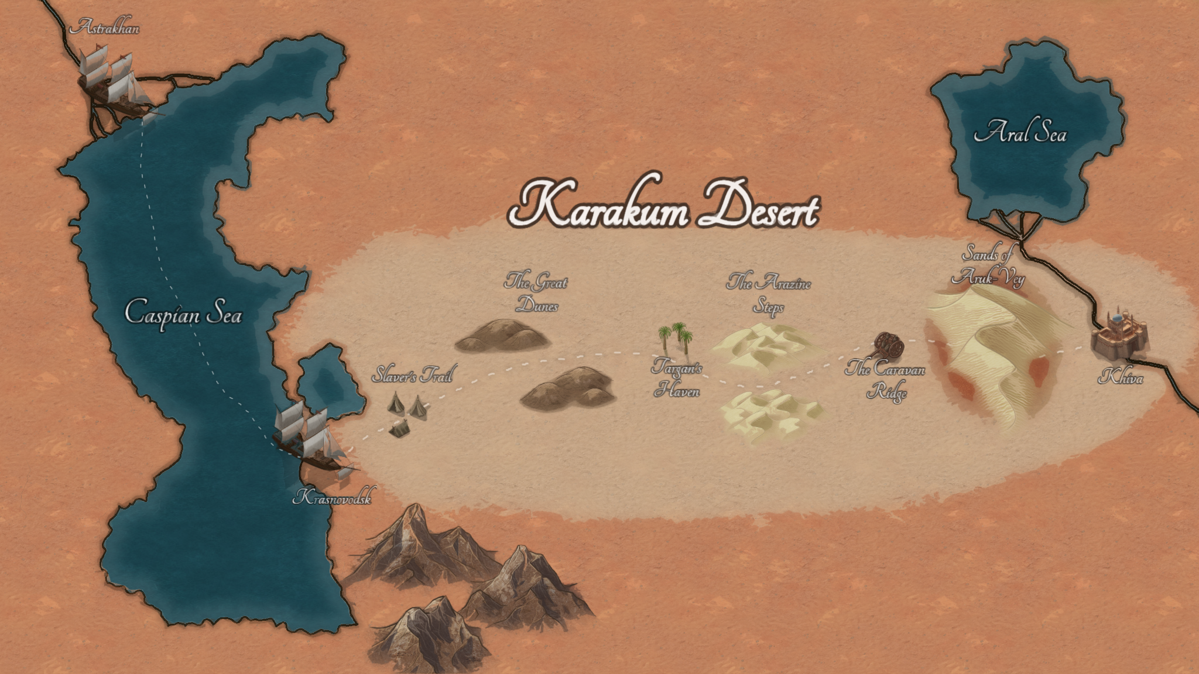

Slide 40


Slide 41
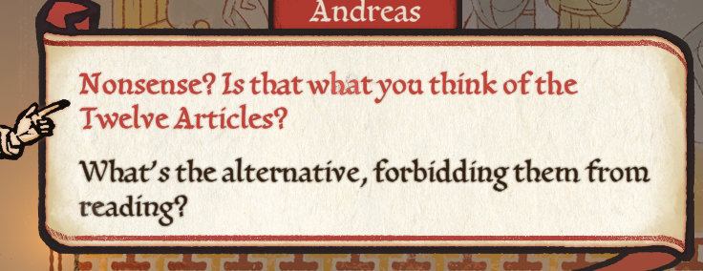

Slide 42


